Slide 1
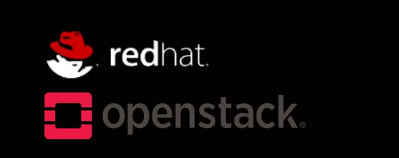
OpenStack Architecture

Slide 2
OpenStack Services
Compute & Hardware Lifecycle
Orchestration
NOVA: Compute Service (VMs)
ZUN: Containers Service
IRONIC: Bare Metal Provisioning
CYBORG: Accelerators (GPUs, FPGAs, DPUs)
HEAT: Orchestration
MISTRAL: Workflow Service
ZAQAR: Messaging Service
BLAZAR: Resource Reserving Service
AODH: Alarming Service
Storage Services
Shared Infrastructure
SWIFT: Object Storage Service
CINDER: Block Storage Service
MANILA: Shared File Systems (NFS/CIFS)
KEYSTONE: Identity Service
PLACEMENT: Resource Inventory Tracker
GLANCE: Image Service
BARBICAN: Key Management & Secrets
Networking & DNS
NEUTRON: Networking Service
OCTAVIA: Load Balancer Service
DESIGNATE: DNS-as-a-Service
Workload Provisioning
MAGNUM: Container Orchestration Engine Provisioning
TROVE: Database as a Service (DBaaS)
Web Frontends
Application Lifecycle
HORIZON: OpenStack Dashboard Web Interface
SKYLINE: Next Generation Dashboard
FREEZER: Backup and Restore Service
MASAKARI: Instances High Availability Service

Slide 3






OpenStack Services
Compute
Hardware Lifecycle
IRONIC
NOVA
Bare Metal Provisioning Service — Provisions and manages physical hardware (bare metal servers) rather than virtual machines, providing full control over the physical infrastructure.
Compute Service — Nova is the OpenStack compute service responsible for provisioning and managing large-scale, on-demand virtual machines and instances across hypervisors.
ZUN
CYBORG
Containers Service — Provides an API for launching and managing containers as first-class resources, seamlessly integrating with Neutron networks and Cinder volumes.
Lifecycle Management of Accelerators - Provides lifecycle management for hardware accelerators such as GPUs, FPGAs, and SmartNICs, enabling them to be attached and utilized by virtual machines or bare-metal instances.

Slide 4





OpenStack Services
Storage
Network
SWIFT
NEUTRON
Object Store — Object storage service designed to store and retrieve unstructured data massively and reliably across clusters using RESTful APIs.
Networking — Provides networking-as-a-service, enabling users to create and manage software-defined networks, subnets, routers, security groups, and floating IPs for compute instances.
CINDER
OCTAVIA
Block Storage — Provides persistent, high-performance block storage volumes (similar to virtual hard disks or SAN storage) to compute instances like virtual machines or bare-metal servers.
Load Balancer — Provides scalable, fault-tolerant, and on-demand load balancing to distribute incoming application traffic across multiple compute instances.
MANILA
DESIGNATE
File Share — that provides scalable, multi-tenant file storage (such as NFS and CIFS/SMB) allowing multiple compute instances to simultaneously access, read, and write to the same shared directory.
DNS Service — Provides scalable, multi-tenant DNS management, allowing users to create, manage, and automate DNS zones, records, and domains via REST APIs.

Slide 5


OpenStack Services
Web Frontends
HORIZON
OpenStack dashboard service that provides a web-based, self-service graphical user interface for administrators and users to interact with and manage various OpenStack services.
SKYLINE
OpenStack lightweight, web-based dashboard designed as a modern, high-performance alternative to Horizon, providing a clean user interface for managing cloud resources.

Slide 6

OpenStack Services
Orchestration
HEAT
BLAZAR
Automates the deployment and management of complex cloud infrastructures using templates, allowing users to define resources, relationships, and configurations in a single declarative file.
OpenStack resource reservation service that allows users to book and schedule compute, storage, and networking resources in advance to guarantee capacity for specific workloads or scheduled jobs.
MISTRAL
Component designed to define, execute, and manage complex operational workflows and task automations via a domain-specific language (DSL).
AODH
OpenStack alarming service that evaluates alarms defined against telemetry data collected by Ceilometer, triggering automated actions or notifications when specified performance and metric thresholds are breached.
ZAQAR
multi-tenant cloud messaging and notification service that provides a high-performance web messaging API for web applications and distributed components to coordinate tasks, queue messages, and publish-subscribe events.

Slide 7




OpenStack Services
Shared Infrastructure Services
KEYSTONE
PLACEMENT
Identity Service – Provides centralized authentication, authorization, and service cataloging, managing user accounts, projects, roles, and access permissions across all cloud services.
Tracks resource inventories, classes, and usages across the cloud, providing precise tracking and querying capabilities to help the scheduler match compute instances with suitable host resources.
GLANCE
BARBICAN
Image service – Stores, discovers, and retrieves virtual machine disk images and metadata, serving as a registry where users can upload and manage bootable operating system templates.
Key service - Provides secure storage, provisioning, and lifecycle management for sensitive data such as symmetric keys, asymmetric keys, certificates, and raw secrets.

Slide 8
OpenStack Services
Workload Provisioning
Application Lifecycle
MAGNUM
FREEZER
OpenStack container orchestration service that provisions and manages container cluster management platforms—such as Kubernetes, Docker Swarm, and Apache Mesos—as first-class resources using Heat and Glance.
OpenStack backup, restoration, and disaster recovery service that provides automated, efficient, and resource-optimized data protection for file systems, databases, block storage volumes, and cloud instances.
TROVE
MASAKARI
Database as a Service (DBaaS) - component that provisions, manages, and scales both relational and non-relational database engines, automating administrative tasks such as backups, replication, and recovery.
OpenStack instance high availability service that automates recovery and failover procedures for virtual machines and compute hosts when infrastructure or service failures occur, minimizing application downtime.

Slide 9
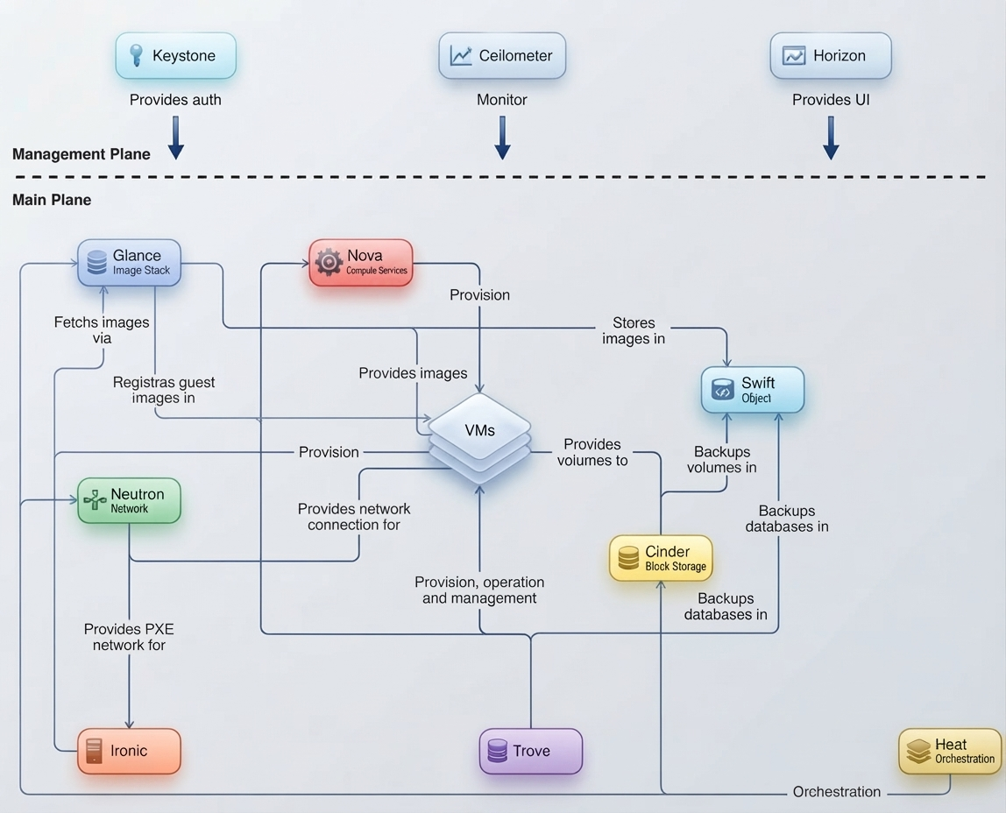
OpenStack Conceptual Architecture

Slide 10
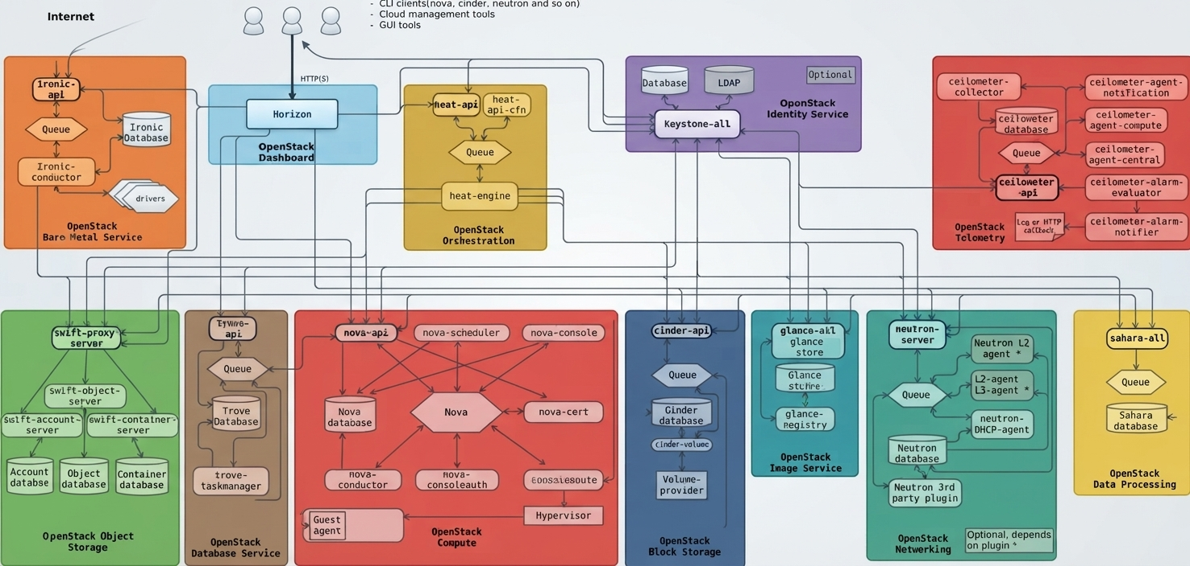
OpenStack Logical Architecture

